Slide 1

AI in the Real World
Daniel Velasco
Semester Project — Artificial Intelligence

Slide 2
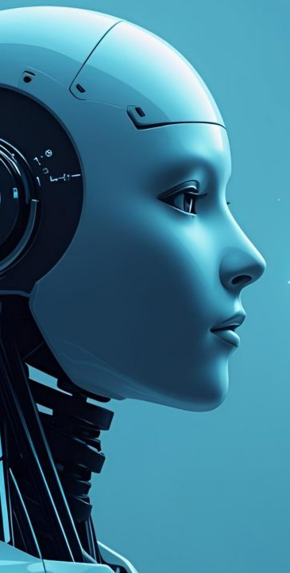
What is Artificial Intelligence?
• AI enables machines to perform tasks requiring human intelligence.
• Narrow AI: Single-task intelligent systems.
• General AI: Human-level intelligence (future goal).
Notes:
Artificial Intelligence refers to machines performing tasks that typically require human intelligence—like recognizing patterns, making decisions, or learning from data. There are two major types: Narrow AI and General AI. Narrow AI is what we use today—systems designed for specific tasks, such as chatbots, recommendation engines, or medical scan analysis. General AI, which would match human-level intelligence across all tasks, does not exist yet, but research continues to push in that direction

Slide 3
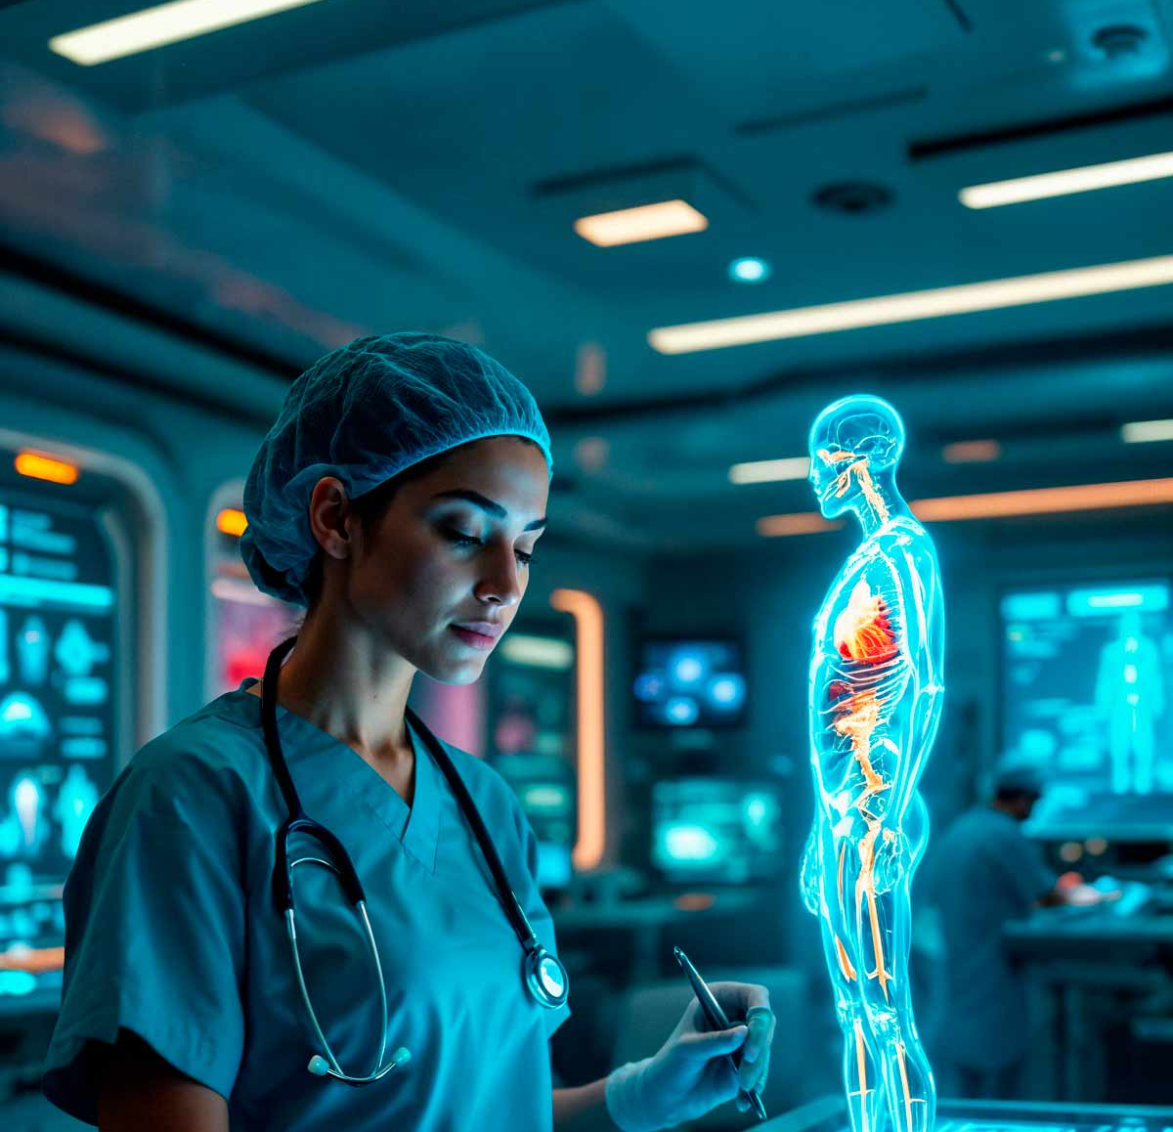
AI in Healthcare
• AI analyzes X-rays, CT scans, and MRIs.
• Predictive disease modeling.
• Personalized treatment recommendations.
Notes:
One of the most impactful uses of AI is in healthcare. AI models can analyze medical scans like X-rays and CT scans more quickly and sometimes more accurately than human specialists. Predictive models help doctors anticipate disease risks, while personalized treatment recommendations use patient data to tailor care. Overall, AI is improving accuracy, efficiency, and early diagnosis

Slide 4
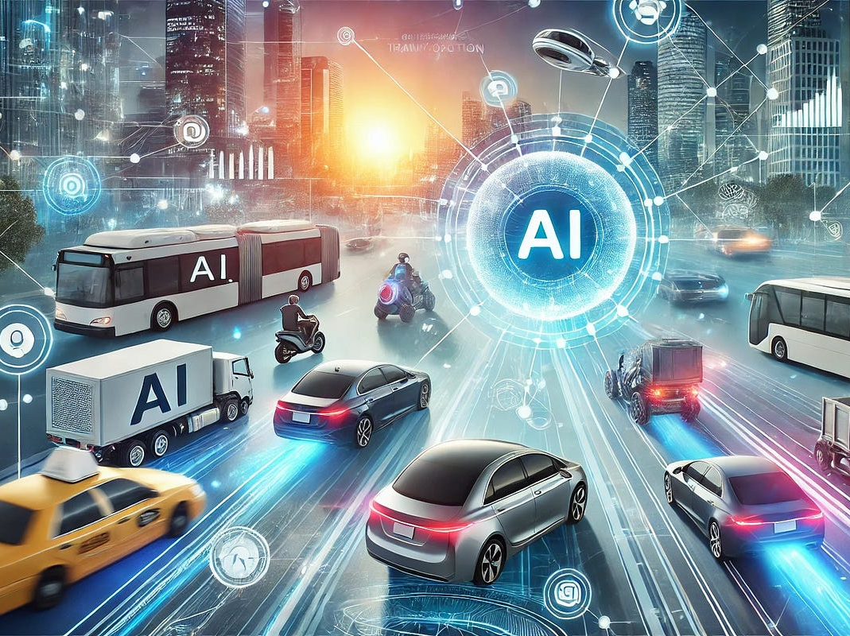
AI in Transportation
• Autonomous driving systems.
• Smart traffic coordination.
• Predictive maintenance for fleet vehicles.
Notes:
Transportation is another area transformed by AI. Autonomous driving systems use cameras, radar, and deep learning to detect objects, stay in lanes, and make real-time decisions. AI also powers smart traffic systems that reduce congestion by adjusting traffic signals based on real-time data. For commercial fleets, AI predicts maintenance needs before breakdowns happen, lowering repair costs and improving reliability

Slide 5
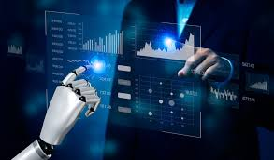
AI in Finance
• Real-time fraud detection.
• Algorithmic stock trading.
• Personalized financial recommendations.
Notes:
In finance, AI helps detect fraud by spotting unusual patterns across millions of transactions instantly. Algorithmic trading uses AI to buy and sell stocks at speeds no human could match, reacting to market changes in milliseconds. Banks also use AI to personalize financial advice, recommend products, and improve customer service

Slide 6
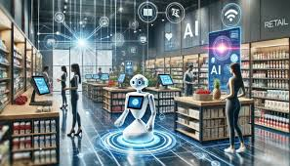
AI in Retail & Customer Service
• Recommendation engines.
• Inventory forecasting.
• AI-powered chatbots.
Notes:
In retail, AI drives recommendation systems like the ones used by Amazon and Netflix. These algorithms learn your preferences and predict what you’re most likely to buy or watch next. AI also optimizes inventory so stores don’t overstock or understock products. And chatbots provide 24/7 customer support, reducing wait times and improving accessibility

Slide 7
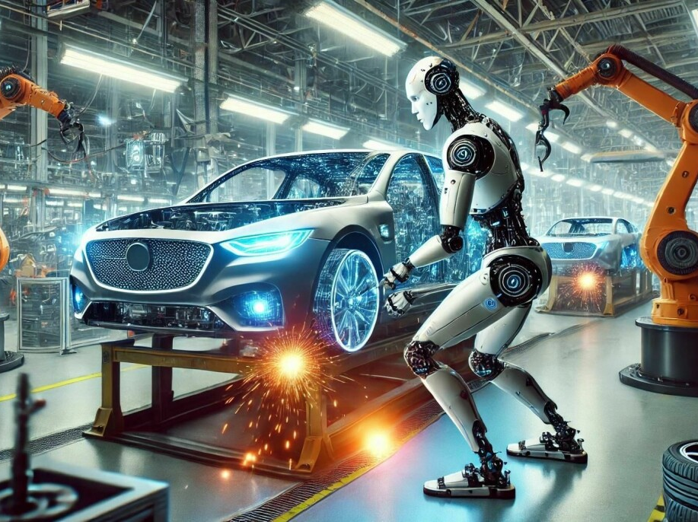
AI in Robotics & Manufacturing
• Automation of repetitive tasks.
• AI-driven quality inspection.
• Human–robot collaboration.
Notes:
Manufacturing uses AI-powered robots to automate repetitive tasks, improving efficiency and precision. AI systems also perform quality checks by detecting defects that the human eye might miss. In many factories, robots and humans now work side-by-side, with AI ensuring safety and coordination

Slide 8
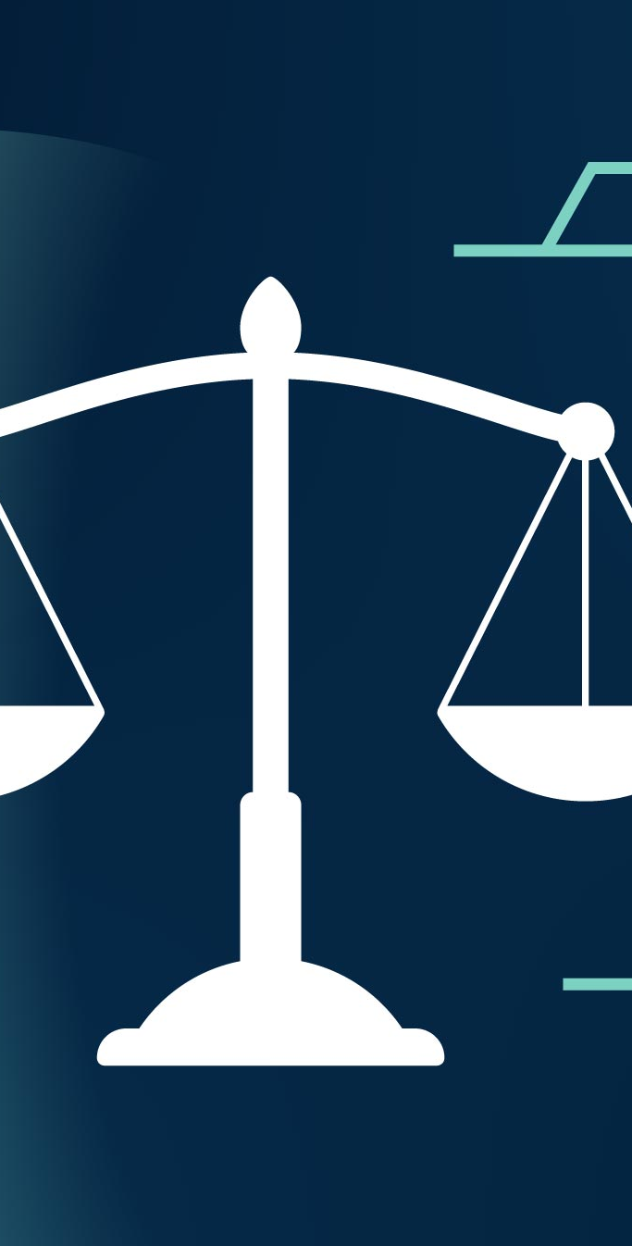
Ethical Considerations
• Mitigating AI bias.
• Ensuring transparency.
• Prioritizing safety and accountability.
Notes:
While AI offers incredible benefits, there are important ethical concerns. AI systems can inherit bias from the data they’re trained on, which can lead to unfair outcomes. Transparency is also a challenge—many AI models act like black boxes, making decisions without clear explanations. And as AI grows more powerful, safety and responsible development become critical priorities

Slide 9
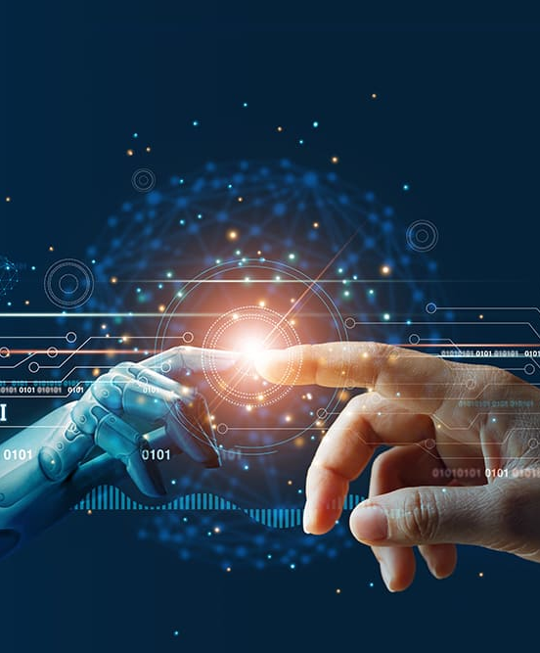
Future Outlook
• Expansion of AI across industries.
• Human–AI collaborative systems.
• Increased efficiency and innovation.
Notes:
The future of AI involves deeper integration into almost every industry. AI will continue making processes more efficient, enabling faster decision-making, and helping humans solve complex problems. Instead of replacing humans, AI is increasingly being used as a collaborative tool that enhances human abilities

Slide 10
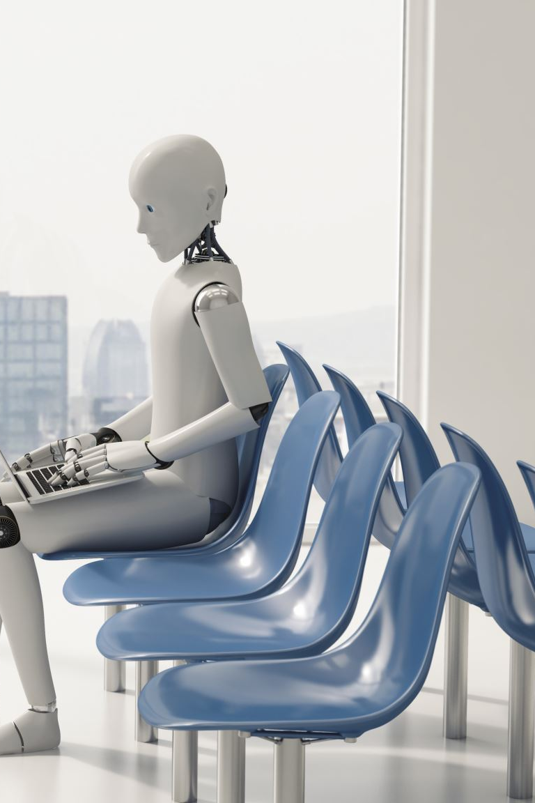
Conclusion
AI is transforming healthcare, finance, retail, robotics, and more.
Understanding AI prepares us for an AI-driven future.
Notes:
In conclusion, AI is already transforming healthcare, transportation, finance, retail, and manufacturing. Understanding how AI works and where it’s headed is essential as we enter a world where intelligent systems play a major role in our everyday lives. Thank you for watching my presentation

